Slide 1
Professional Practices
Computer Ethics

Slide 2
Week 2 Topics Covered
Computer Issues and Moral and Ethical Problems
History of Computer Ethics
Definition of Ethics
Real World Scenarios

Slide 3
Categories of Computer Issues
Privacy
Computers create a false sense of security
People do not realize how vulnerable information stored on computers are
Property
Physical property
Intellectual property (in both copyright and patent)
Data as property
Access
Access to computing technology
Access to data
Accuracy
Accuracy of information stored

Slide 4
Moral and Ethical Problems
Hacking, cracking and virus creation
Serious crimes that cannot be justified
Attempts at justifying such actions
Electrons are free- they do not belong to anybody
Companies have weak protection
Point out flaws and vulnerabilities in information systems
Hacking or virus creation is right in a particular country or culture
Software piracy
Unauthorized copying of software is stealing
It is morally wrong as it constitutes a violation of someone else’s rights

Slide 5
History of Computer Ethics
1940-1950: Founded by MIT prof Norbert Wiener: cybernetics-science of information feedback systems.
1960s: Donn Parker from California examined unethical and illegal uses of computers by professionals. 1st code of professional conduct for the ACM.
Mid 1970: Walter Maner taught 1st course and starter kit in computer ethics.
Notes:
[standford, 2001]

Slide 6
History of Computer Ethics
1980: Issues like computer-enabled crime, disasters, invasion of privacy via databases, law suits about software ownership became public.
Mid 80s: James Moore of Darmouth, Deborah Johnson of Rensselaer, Sherry Turkle of MIT, and Judith Perrole published article and books.

Slide 7
History of Computer Ethics
1990: Interest in computer ethics as a field of research had spread to Europe and Australia.
Simon Rogerson of De Montfort University (UK) Terrell Bynum, editor of Metaphilosophy (USA), initiated international conferences.
Mid 90s: Beginning of a 2nd generation of computer ethics with more practical action.

Slide 8
What is Computer Ethics?
Ethical problems aggravated, transformed or created by computer technology. (Maner)
Old ethical problems made worse by computers – e.g. data security/privacy
others came into existence because of computer technology – e.g. data loss due to malware, online hacking of bank accounts
Pose new versions of standards moral problems and moral dilemmas, exacerbating old problems & forcing to apply ordinary moral norms in uncharted realms. (Johnson)
How would you compare the above two view points?
Notes:
Deborah Johnson defines the study of computer ethics as:
The study of the ethical questions that arise as a consequence of the development and deployment of computers and computing technologies.
It involves two activities:
One is identifying and bringing into focus the issues and problems that fall within its scope, raising awareness of the ethical dimension of a particular situation.
The second is providing an approach to these issues, a means of advancing our understanding of, and suggesting ways of reaching wise solutions to these problems.

Slide 9
Definitions of Computer Ethics
James Moor
The operation of computer systems and their associated communications systems are central to the economies of the developed world.
The social impact of this technology has been immense, changing the environment in which computers are used, and in doing so giving rise to questions of right and wrong.
Moor defines computer ethics as:
The analysis of the nature and the social impact of computer technology and the corresponding formulation and justification of policies for the ethical use of such technology.
He uses the phrase 'computer technology' broadly to include computers and associated technology: including concerns about software as well as hardware and concerns about networks connecting computers as well as computers themselves.
Notes:
Computer ethics concerns with
policy vacuum & conceptual muddle
regarding social & ethical use of computer technology (Moor)
Policy vacuum:
how computer technology should be used.
Often existing policies are inadequate for new capabilities/choice of actions
e.g. making Facebook profile picture public without user’s authorization
Conceptual muddle:
A complex situation in which it becomes absolutely difficult to figure out right vs. wrong

Slide 10
What is Computer Ethics? (contd.)
Computer Ethics identifies & analyzes the impact of I.T on such social & human values
as health, wealth, work, knowledge, opportunity, freedom, democracy, privacy, security etc. (Bynum)
Professional ethics – guide the day to day activities of computing professional, whoever involved in design & development of computer artifacts. (Gotterbarn)

Slide 11
Summarized definitions of Computer Ethics
Maner’s ------ ethical problems transformed into new ones
Johnson’s-------new version of moral problems
Moor’s---------- Computer technology including concerns about software as well as hardware
Bynum’s------impact of I.T on social & human values
Gotterbarn’s-----guide day to day activities of computing professionals

Slide 12
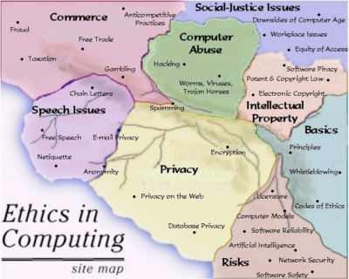

Slide 13
Ethical Scenarios
A good place to start on this course is to look at the reasons why we should study it at all.
To facilitate this, we look at a few scenarios.
Using a software trial version for 12 months, saying that s/he is evaluating it before deciding to buy it. Whether such conduct is ethical?
A catastrophic bug has been identified just a day before deploying a safety critical software. The QA team has been warned not to report the bug to avoid delay in deploying software. Is it ethical?

Slide 14
Ethical Scenarios (contd.)
A software that can predict the radiation of a nuclear system up to 75% accuracy, is to be developed, the software has acquired 74.6% accuracy. The manager has decided to round it off to meet client’s requirement.
Is it ethical?

Slide 15
Scenario: Should I copy software?
Javid invests a small amount in the stock market.
Last year he bought and successfully employed a software package to help him with his investments.
Recently, he met Mazhar who was also interested in using the software.
Mazar borrowed the package, copied it and then returns it.
Both knew that the software was proprietary but did not read up the details.
Did Javid and Mazhar do anything wrong, if so what? Something to consider:
Should software package be lent?
When is it justifiable to break the law?
Bad law, inappropriate law or if the law is easy to break?
Do your self to find answers

Slide 16
Scenario: Should a company’s Data mine?
Inga sells hardware and software to over 100 000 customers per year.
She has 10 years’ experience. As part of the billing process she keeps information on customers. She buys and uses a data mining tool to derive useful information about her client’s information such as zip codes, credit card numbers, ID numbers etc. Most of this information identifies groups and not individuals. She can then use the information to market her wares more efficiently. Is this ethical since customers did not give her the information for this purpose?
Something to consider:
• Should customer be notified?
• Is there a need for establishment of a policy? What should this policy look like?
• Professional responsibility (professional Ethics): Do professionals have a responsibility to ensure computing serves humanity well?
Do your self to find answers

Slide 17
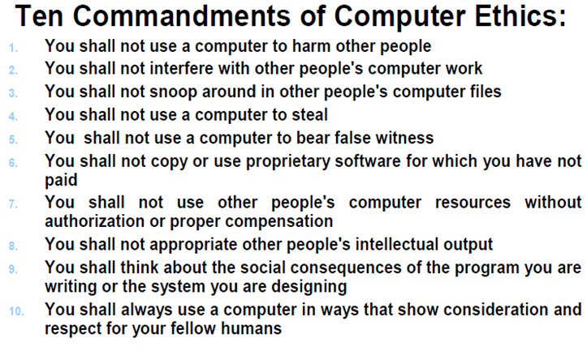
The ethical values as defined in 1992 by the
Computer Ethics Institute
Notes:
The ethical values as defined in 1992 by the Computer Ethics Institute; a nonprofit organization whose mission is to advance technology by ethical means, lists these rules as a guide to computer ethics.
For further reading
https://en.wikipedia.org/wiki/Ten_Commandments_of_Computer_Ethics

Slide 18
Assignment
Prepare a report on following topics: [5]
Computer ethics: Its birth and its future [5]
Ethical problems in computing
Recommended Reading materials:
Bynum, Terrell. (2001). Computer ethics: Its birth and its future. Ethics and Information Technology. 3. 109-112. 10.1023/A:1011893925319.
https://www.comptia.org/blog/ethical-problems-in-computing#:~:text=To%20begin%20with%2C%20it%20seems,%2C%20workers%2C%20and%20customers%E2%80%9D.

Slide 19
Further Readings
Computer Ethics Institute
https://en.wikipedia.org/wiki/Ten_Commandments_of_Computer_Ethics

Slide 20
Thank you!

